Slide 1

United Airlines Merger with Continental Airlines 2010
Following its 2010 merger with Continental Airlines, United Airlines IT Team had to keep the underlying reservation system, baggage-handling system, public website, aircraft maintenance records, database servers, and countless other computer systems running flawlessly around the clock.
United.com IT staff wanted to ensure its infrastructure had the resilience, scalability, and manageability required to boost the airline’s competitive position in the aviation industry.
“We can’t afford any service outages, so it was important to pick the right high availability and disaster recovery (DR) solution: resilient, flexible, easy-to-use, and cost-effective,” says Richard Wilson, Principle Architect, Microsoft Private Cloud and Windows Server at United Airlines.
ON July, 2012
Source: https://customers.microsoft.com/Pages/CustomerStory.aspx?recid=11155

Slide 2

Taking a Proactive Approach to IT Infrastructure Resiliency
A multibillion-dollar global financial services company was facing challenges in meeting its IT service availability objectives
The rapid growth of the company's IT and storage infrastructure, the continuous implementation of new technologies, and the outsourcing of key IT operations to a third party had resulted in greater exposure to risk, as well as increased difficulty in effectively planning and conducting audits and disaster recovery (DR) tests. As a result, a decision was made to adopt a more proactive approach to infrastructure resiliency management. As part of this change, new service availability targets were established for the entire business, namely a 24-hour recovery time objective (RTO) and a 30-minute recovery point objective (RPO)
Source: continuity software

Slide 3
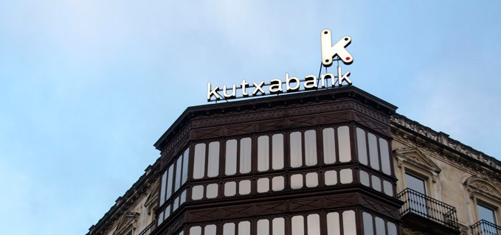
Reputation concerns Influence Resiliency programs
Banks today are seeking services to meet their constantly evolving and complex technology needs.
One of the biggest risk domains that banks measure themselves against is reputation. So the first place they tend to focus on is customer-facing channels such as mobile banking, online banking and the branches. Banks are keen to harden the front end, and they’re designing continuous availability into those customer interfaces. With more than 60% of bank transactions happening outside a bank branch, the goal is to define the systems necessary for an always-on interface.
Continuous Availability , Enhanced resilience and security of customer data is of utmost importance to Kutxabank .
Source:ibm.com/services/resiliency

